Slide 1
Welcome!
Thanks a lot for joining us
Notes:
© Copyright Showeet.com – Creative & Free PowerPoint Templates

Slide 2
Basic Fundamentals of Computer Programming
- Ada Lovelace has been called the world's first computer programmer
Notes:
© Copyright Showeet.com – Creative & Free PowerPoint Templates

Slide 3
Concept of Program
01
What is Program & Programming ?
04
What is Machine Language ?
Which two signals can the computer understand ?
02
What is Computer ?
05
03
What Kind of Device Computer is ?
06
What is Meant by binary 1 & 0 ?
Notes:
© Copyright Showeet.com – Creative & Free PowerPoint Templates

Slide 4
Programming languages can be divided into five levels or generations according to its characteristics :
Very High Level Language
Machine Language
Assembly Language
Mid Level Language
High Level Language
1st Gen Language
2nd Gen Language
3rd Gen Language
4th Gen Language
5th Gen Language
Notes:
© Copyright Showeet.com – Creative & Free PowerPoint Templates

Slide 5
Some Important Languages of Programming
Programming Languages | Year
Fortran | 1954-57
Lisp | 1956-59
Cobol | 1959-60
Basic | 1964
Pascal | 1970
C | 1972
Programming Languages | Year
C++ | 1983
Perl | 1987
Python | 1989
PHP | 1995
Java | 1995
JavaScript | 1995
Notes:
© Copyright Showeet.com – Creative & Free PowerPoint Templates

Slide 6
c
Print “Hello World” in some different Languages
#include <stdio.h>
int main() {
printf("Hello World");
return 0;
}
#include <iostream>
int main() {
std::cout << "Hello World";
return 0;
}
import java.io.*;
class hello {
public static void main (String[] args) {
System.out.println("Hello World");
}
}
C
C++
Java
Notes:
© Copyright Showeet.com – Creative & Free PowerPoint Templates

Slide 7
c
Print “Hello World” in some different Languages
console.log("Hello World");
fun main(args: Array<String>){
println("Hello World")
}
print("Hello World")
JavaScript
Kotlin
Python
Notes:
© Copyright Showeet.com – Creative & Free PowerPoint Templates

Slide 8
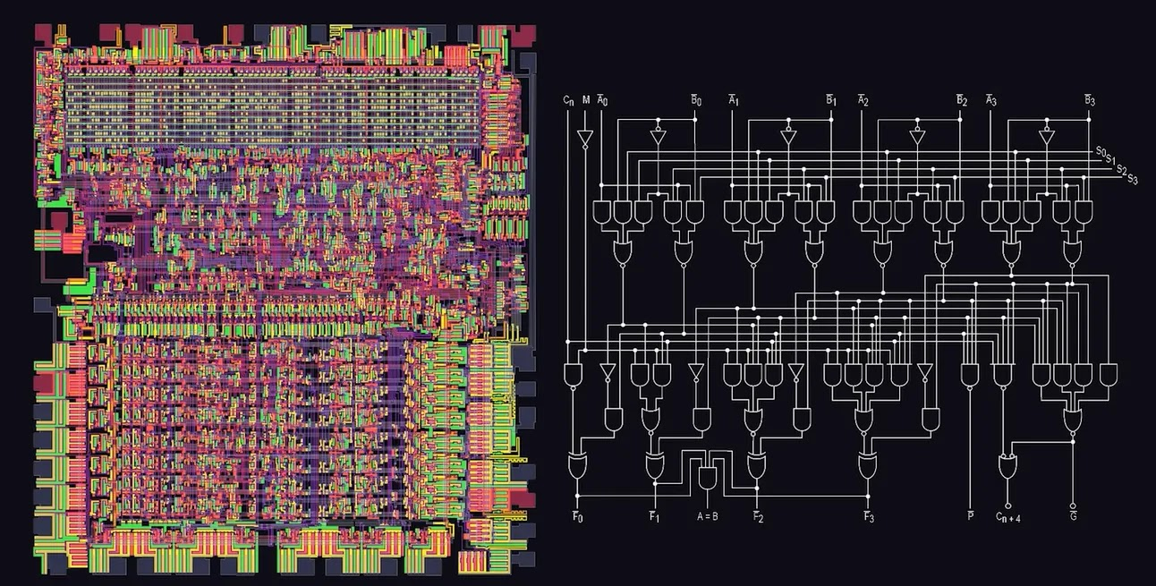
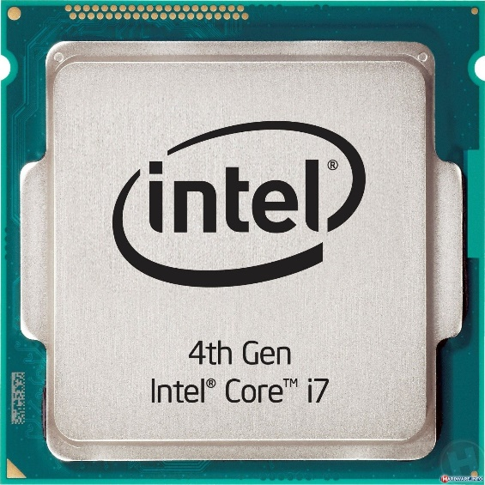
🔰 What is the “BRAIN” of a Computer ??
👉🏻 Central Processing Unit or the CPU is the brain of the computer. The CPU is the brain of the computer, CPU stands for Central Processing Unit. A typical CPU consists of a RAM, ROM, and motherboard. The brain is what that do all work and processing and that work done by the CPU unit in the computer.

Slide 9
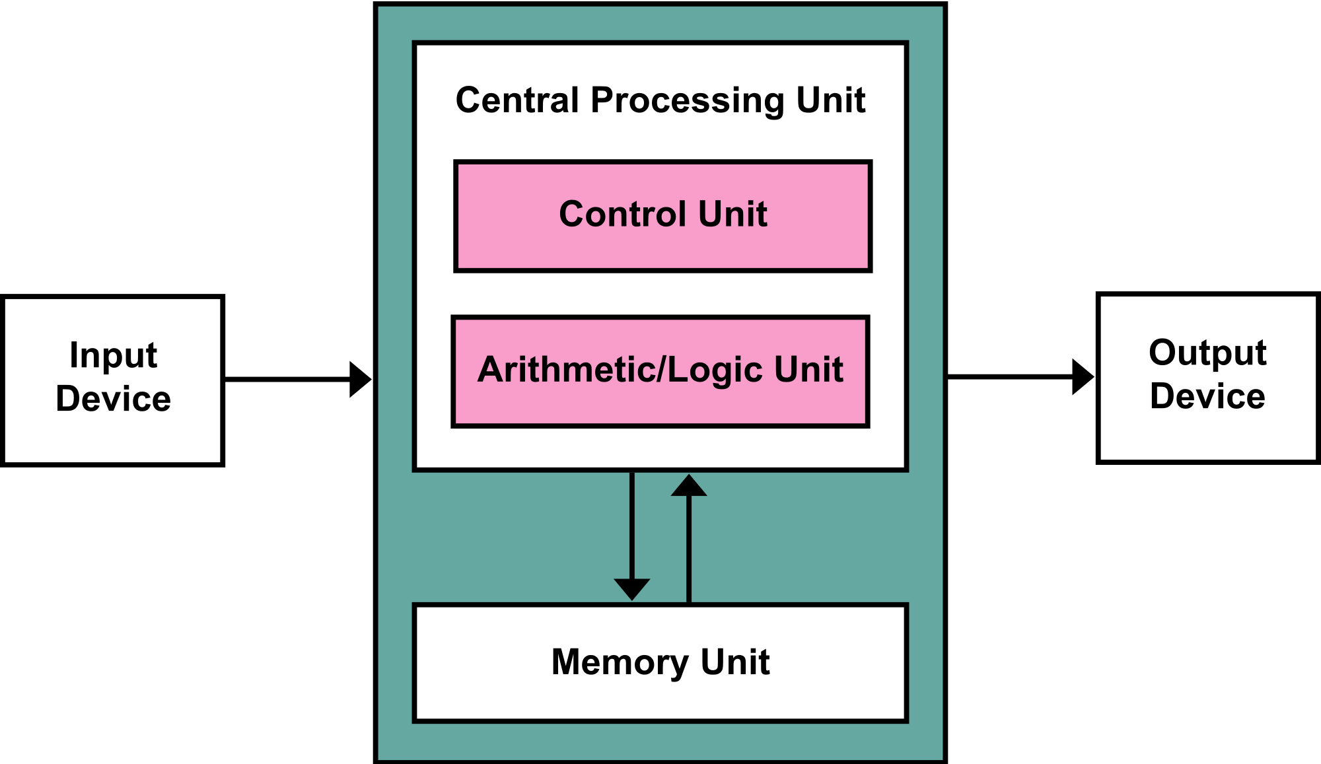
CPU Architecture Diagram
CU 👉🏻 Looping, Branching etc.
ALU 👉🏻 Arithmetic Operations
Notes:
© Copyright Showeet.com – Creative & Free PowerPoint Templates

Slide 10
🔰Types of Computer Memory
Volatile
Ram, Register
Non-Volatile
Hard Disk, CD
Pendrive
Cache Memory
Notes:
© Copyright Showeet.com – Creative & Free PowerPoint Templates

Slide 11
🔰Memory Unit Architecture
Low
High
Register
RAM
Virtual Memory
Cache – L1
Cache – L2
Capacity
Speed, Price
High
Low
Notes:
© Copyright Showeet.com – Creative & Free PowerPoint Templates

Slide 12
🔰 Which Level Language C is ??
👉🏻 C language is belonging to middle level language
GmHasan
Notes:
© Copyright Showeet.com – Creative & Free PowerPoint Templates

Slide 13
What Kind of Language C is ??
👉🏻 C is a General Purpose, Statically typed, Structured based Programming Language
GmHasan
Notes:
© Copyright Showeet.com – Creative & Free PowerPoint Templates

Slide 14
c
🔰 Why Should We Learn C Programming Language ?
C is The Mother of All Programming Languages
C is The Pillar of Our Programming Journey
C Helps Us to Think Like Computer Scientist Rather Than Software Engineer
We’ll Understand How and Why Rather Than What is Happening
Simply, Easy to Understand Syntax & Very Straightforward
Probably The Fastest Programming Language on The Planet
Notes:
© Copyright Showeet.com – Creative & Free PowerPoint Templates

Slide 15
Thank You!
Gazi Mehedi Hasan
Front-End developer
Jatrabari Wapda Colony
+01316444147
gmhasan81@outlook.com
https://www.github.com/gmhasan
Do you have any questions?
Photo credit: PeterArreola via Pixabay (Creative Commons Zero license)
Notes:
© Copyright Showeet.com – Creative & Free PowerPoint Templates

Slide 16
C
Notes:
© Copyright Showeet.com – Creative & Free PowerPoint Templates

